Slide 1
Doctoral/Post-Doctoral Online Seminar on Social-Symbolic Work
Thomas B. Lawrence University of Oxford | Nelson Phillips Imperial College

Slide 2
Institutional Work

Slide 3
Institutions as social-symbolic objects
The simple definition: “conventions that are self-policing”
Conventions: a shared, social understanding of a practice, technology or rule (or other object)
Subject to self-regulating controls that create pressure to act according to the convention
  The even simpler distinction we make from a social-symbolic work perspective is that institutions are ideational objects: they are the “concept of” something

Slide 4
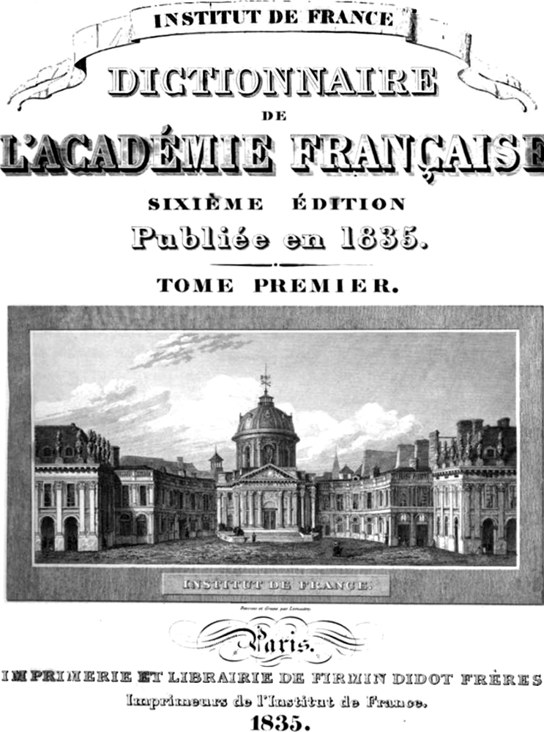
A history of the institution as an object
Pre-modern
  Enduring ideas/conventions emanating from nature or God
The modern institution
  The product of human effort
  Potentially perfectible
The postmodern institution
  The outcome of a complex mix of action and circumstance
  Changeable but not perfectible

Slide 5
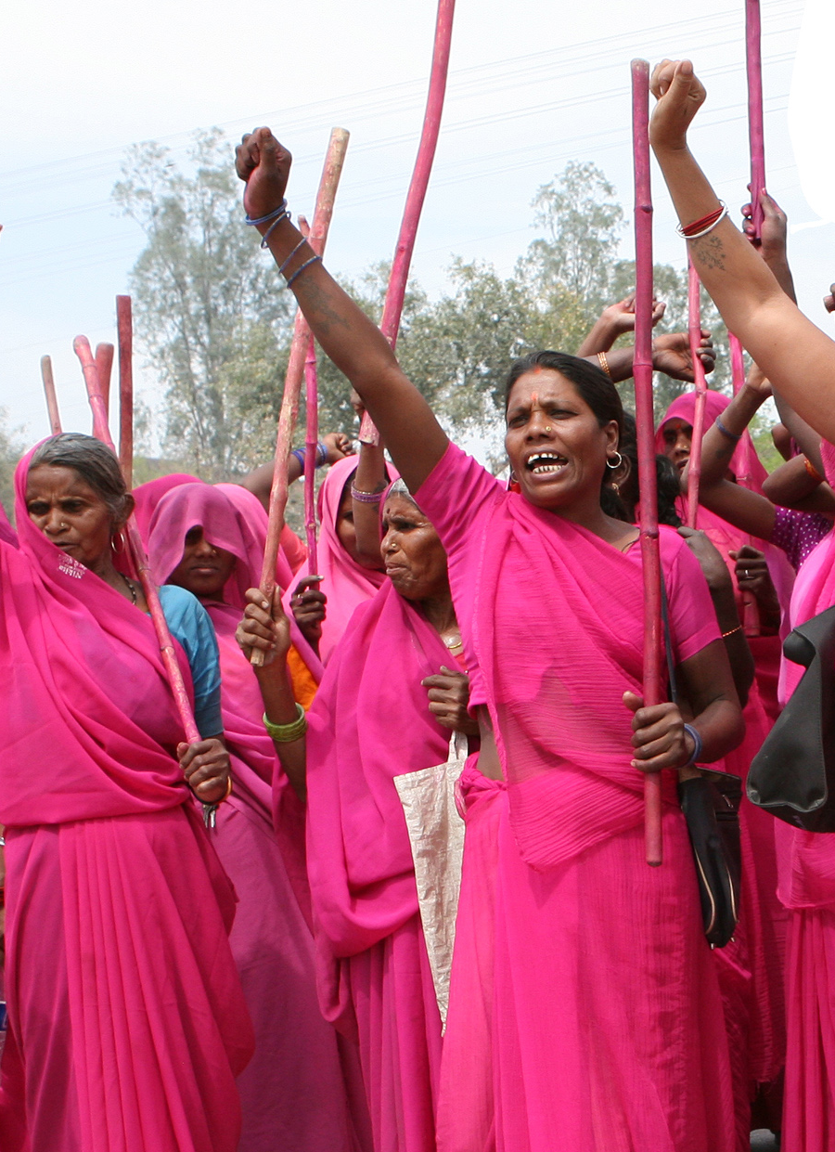
The Gulabi Gang
World’s largest women’s vigilante group
20,000 members
Targets corrupt officials and violent husbands
Interventions begin with dialogue/negotiation
Extensive use of slogans
Counter-aggression techniques:
  "smearing abusive men with chili powder"
  using "lathis," the baton carried by local police officers

Slide 6


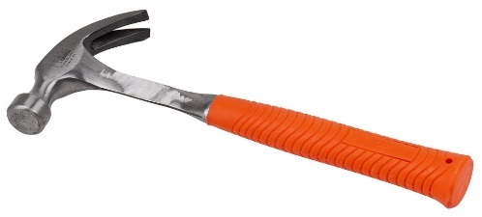
Dimensions of Institutional work
Discursive
  Discourse is central to the construction, maintenance, and transformation of institutions
  Discursive approaches dominate empirical studies of institutional work
Relational
  Research on institutional work tends to overlook this dimension
  Most studies concentrate on similar groups of actors, or actors in conflict
Material
  Obviously important and largely overlooked
  Multiple streams of research to draw on in the social sciences

Slide 7
Accessing institutional work
Short breakout task (also on the Jamboard): (10 minutes)
One of the challenges in studying institutional work is accessing its relational and material dimensions
In your groups, can you each share either:
  Examples of research you have seen that show the relational or material dimensions of institutional work
  What factors make it challenging to study the relational and material dimensions of institutional work?
  Please put your answers for (a) on Jamboard page 2 and (b) on page 3

Slide 8
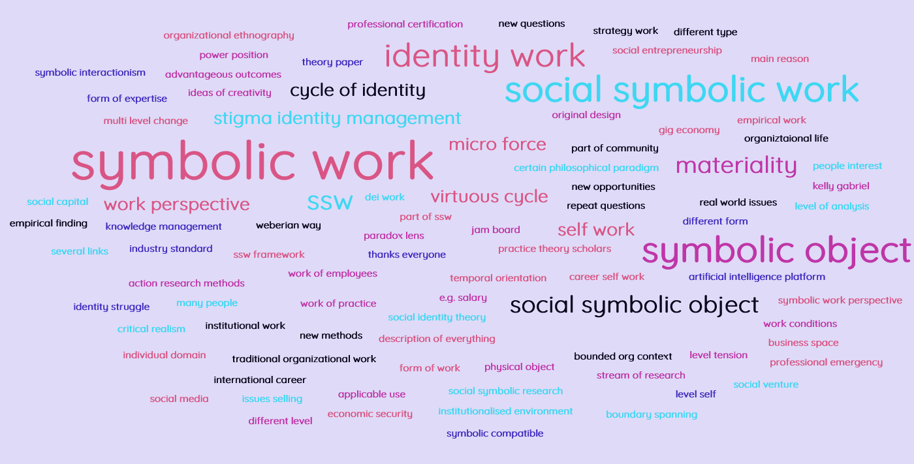

Slide 9
From the “one question” exercise
What distinguishes objects from institutions?
  All institutions are objects
  Institutions are ideational objects (concepts)
Where does institutional work fit in the overall concept of social-symbolic work?
  An important but perhaps over-stretched form of social-symbolic work

Slide 10
Practice work
Dominant form of institutional work research
Are all practices institutions?
  Traditional institutional scholarship: "no"
  Or: all practices are indeed institutions (or involve a degree of institutionalization)
Complex relationship between practice theory and practice work

Slide 11
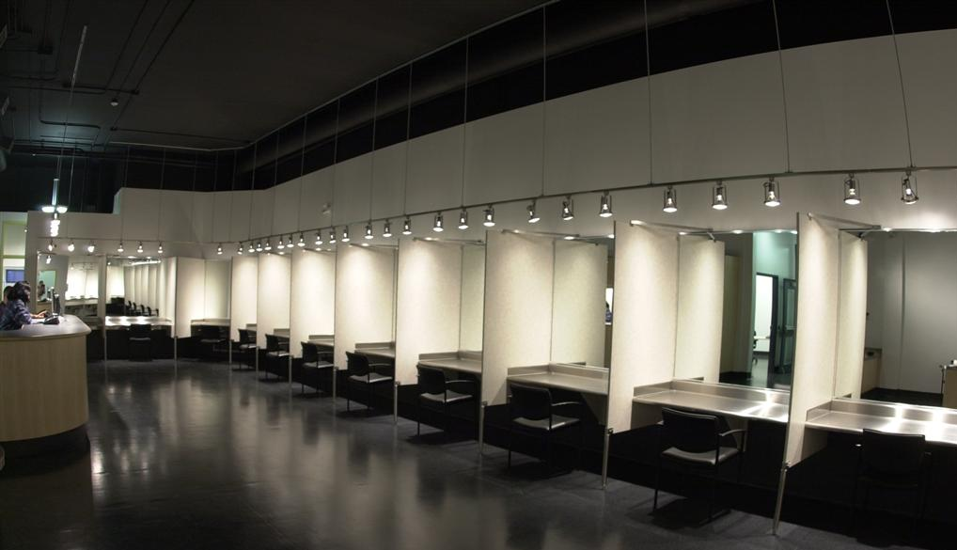

Slide 12

Category work
Focused on categories of objects and people
Research is tied to cognitive and discursive roots
Research tends to overlook its embeddedness in ecologies of categories and social networks
Healthy
Smokes

Slide 13
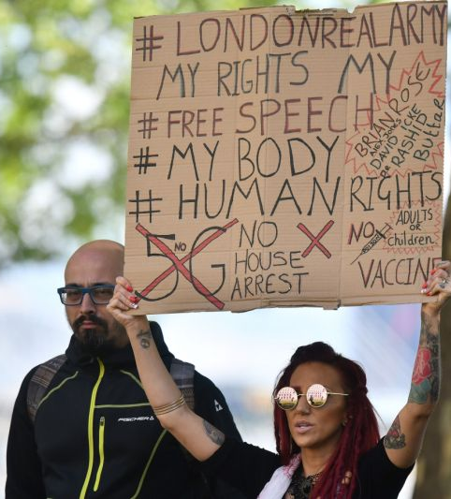
Institutional work in the time of covid-19
In groups of 3, draw on the reading (“In the time of the COVID-19 pandemic, …”) to discuss:
What kinds of institutional work have you observed in relation to vaccination (in your lives as well as in the article)?
What could be a productive research question about vaccination that would connect institutional work to another academic literature?
(You have 15 minutes for the breakout. This exercise is on p. 4 today’s Jamboard. Please put your answers on pages 5 and 6)

