Slide 1
Doctoral/Post-Doctoral Online Seminar on Social-Symbolic Work
Thomas B. Lawrence University of Oxford | Nelson Phillips Imperial College

Slide 2
Organization Work

Slide 3
Social-symbolic work in management and organization research
Self work
Emotion work
Identity work
Career work
Organization work
Strategy work
Boundary work
Technology work
Institutional work
Practice work
Category work

Slide 4


Slide 5
Organizations as Social Symbolic Objects
An organization is commonly understood as two or more people who interact on an ongoing basis around a shared goal
But organizations are not synonymous with the assemblies of people that animate them
  Much of what is important about organizations lies in the shared understandings held by members and interested external actors, and in the heterogenous relationships among and between this network of actors

Slide 6
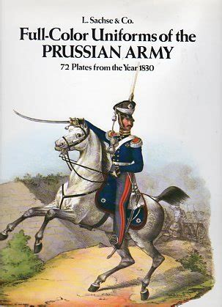
A history of the Organization as an Object
Pre-modern
  Not separate from the humans that composed them
  Tribes, kingdoms, etc
The modern organization
  Word ”organization” appears in the 1700s
  The organization as something separate from its members
  A machine that can be improved
The postmodern organization
  Loss of the idea of “one best way”
  Rationality is limited
  Organizations as one element of an ecosystem

Slide 7
Organization Work
Not all purposeful effort that occurs in organizations is organization work
Organization work is not about work done in organizations
but about working on organizations
  Organization work, then, describes the purposeful, reflexive efforts of individuals, collective actors, and networks of actors intended to shape organizations as social-symbolic objects

Slide 8

What is not Organization Work?
Efforts of actors to shape the idea of an organization is not organization work
For example, the work done by actors in the United States to establish the “B corporation” as a type of organization.
  Organization work, then, describes the purposeful, reflexive efforts of individuals, collective actors, and networks of actors intended to shape organizations as social-symbolic objects

Slide 9
Who does Organization Work?
External actors
Organizational members
Organizational leaders
Others?
An Organization

Slide 10
Organization Work and Work in Organizations
Task: (10 minutes)
Brainstorm forms of organization work you have performed in the last 7 days and put them on the left-hand side of the Jamboard
Brainstorm forms of work in organizations that you have done that ARE NOT forms of organization work (put them on the right-hand side)
In the middle column, put the forms of work that you weren’t sure about (whether or not they counted as organization work)

Slide 11
Strategy Work
Focused on strategy as a social-symbolic object
“Strategy-as-practice” scholarship
  Purposeful, reflexive efforts of actors to shape an organization’s strategy, including such elements as defining an overarching direction for the organization, articulating key resources, mapping the competitive landscape, and creating a narrative that communicates the organization’s strategy to members and external stakeholders

Slide 12
Boundary Work
Focused on boundaries as a social-symbolic object
(1) legal, (2) sphere of influence, (3) competencies, and (4) organizational identity
Who does it?
  Work performed by actors to change or maintain a boundary in or around an organization

Slide 13
A Process Model of Social-Symbolic Work
Practices
Resources
Motivations
Social-symbolic work
Effects
Situatedness

Slide 14

Working from home and Organization Work
This exercise is also on p. 2 of today’s Jamboard so you can see it in your breakout rooms
In groups of 4, answer the following:
What forms of work are involved in successfully managing a workforce working from home?
What actors are doing this work?
Develop a research question based on your discussion that could form the basis for an AMJ article. (the process model is in the Jamboard as a resource for this part of the exercise)
(20 min breakout)

