Slide 1
Self Work

Slide 2
A history of the self
Medieval
  A person was their role in society
The modern self
  A reflexive project
  Interiorization
  Authenticity
The postmodern self
  Saturation – a plurality of “I”s
  Locally rooted
  Transformational

Slide 3
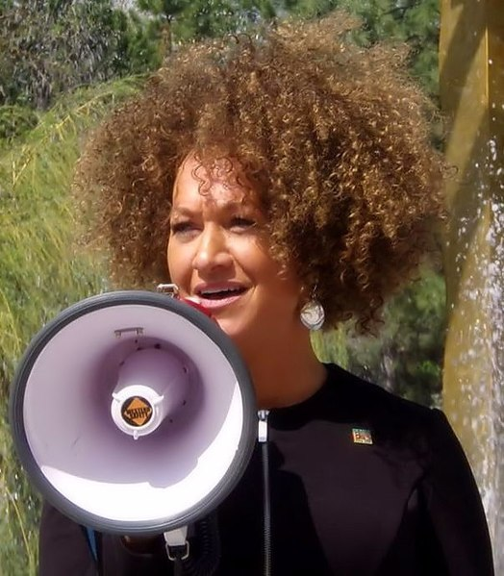
Rachel Dolezal
Former college instructor; former National Association for the Advancement of Colored People (NAACP) chapter president,
Parents publicly stated she was a white person passing as black.
Dolezal had reported to police and local news media that she had been the victim of race-related hate crimes.
Resigned from the NAACP position
Dismissed from her position as an instructor in Africana Studies at Eastern Washington University
2015, Dolezal: she was “born white to white parents” but self-identified as black.

Slide 4
Agents of self work
Focal actors
Connected individuals
Organizations
Social systems
A self

Slide 5
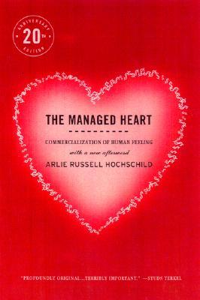
Emotion work
"the act of trying to change in degree or quality an emotion or feeling” (Arlie Hochschild, 1979)
Potentially commoditized → emotional labour
Organizational research: the impact of emotion rules
Conceptualized as self work
  Attached to a broader project – constructing selves

Slide 6

Career work
From careers as sequences and experiences, to careers as socially constructed
Career agency – boundaryless careers, gig economy, side hustles
Conceptualized as self work
  Research opportunity
  Deeply and broadly embedded

Slide 7
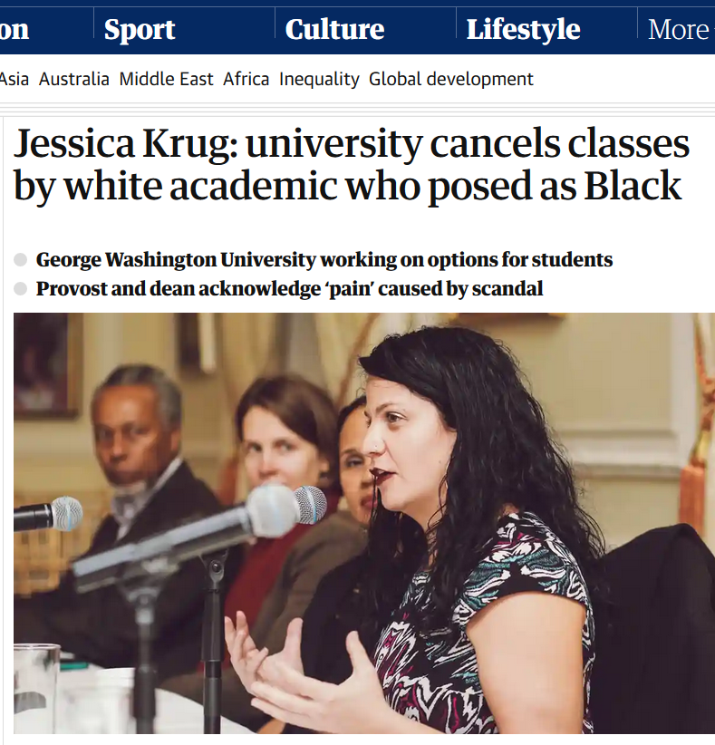
The politics and ethics of self work
In breakout rooms with three other participants for 20 minutes:
What forms of self work can you identify in the reading and what actors are engaging in those forms of self work?
  (On the Jamboard: list 1 or 2 interesting forms of self work you identified and who did them)
What questions does this case raise about the moral and ethical limits of self work?
  (On the Jamboard: Write down one question the case raised for you regarding the moral and ethical limits of self work)

