Slide 1
Doctoral/Post-Doctoral Online Seminar on Social-Symbolic Work
Thomas B. Lawrence University of Oxford | Nelson Phillips Imperial College

Slide 2
Our aims
Develop a sophisticated understanding of the key ideas and issues in the study of social-symbolic work
Provide opportunities to explore new issues, topics, and research questions that emerged from a social-symbolic work perspective
Explore your ideas for the study of social-symbolic work
Interact with other scholars interested in social-symbolic work

Slide 3
Overview of the Social-Symbolic Work Perspective

Slide 4
Snow, D. A., & Anderson, L. 1987. Identity work among the homeless: The verbal construction and avowal of personal identities. American Journal of Sociology.
Whittington, R., Molloy, E., Mayer, M., & Smith, A. 2006. Practices of strategising/ organising: broadening strategy work and skills. Long Range Planning.
Hochschild, A. R. 1979. Emotion work, feeling rules, and social structure. American Journal of Sociology.
1980 1990 2000
Gieryn, T. F. 1983. Boundary-work and the demarcation of science from non-science. American Sociological Review.
Ryen, A., & Silverman, D. 2000. Marking boundaries: culture as category work. Qualitative Inquiry.
Lawrence, T. B., & Suddaby, R. 2006. Institutions and institutional work. Handbook of organization studies (2nd ed.)

Slide 5
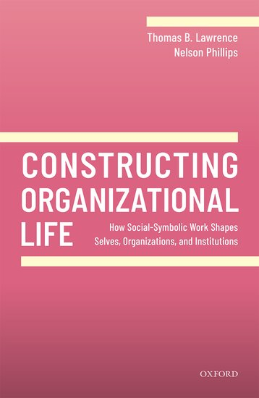

Slide 6
The project
Research question:
  How do people purposefully shape social worlds?
Answer:
  Social worlds are constituted by networks of “social-symbolic objects”
  People shape social worlds by engaging in “social-symbolic work” that targets objects and the connections between them

Slide 7
Social-symbolic objects
A combination of discursive, relational, and material elements
that constitutes a meaningful pattern
in a social system
(Berger & Luckmann, Giddens, Sewell, Fairclough)
  Emotions as social-symbolic objects
  Culturally legitimate patterns of feeling and expression that include important bodily elements

Slide 8
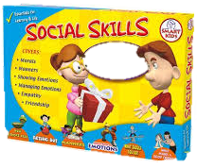
A quick game to get us going
Background:
We define “social-symbolic objects” as “meaningful ‘patterns’ in social systems”
Three broad categories: selves, organizations, institutions
The Game:
2 minutes on your own:
  Make a list of social-symbolic objects that have come into existence in your lifetime.
  No discussing your answers or asking questions
8-minute breakout:
  Share, and compare
  Be ready to put a few of your answers in sticky notes on our shared Jamboard (the link is being put in the chat right now – bookmark it as we’ll be coming back to it throughout the course)

Slide 9
Social-symbolic work
Purposeful, reflexive efforts of individuals, collective actors, and networks of actors to shape social-symbolic objects
heterogeneous forms of agency
(Emirbayer & Mische)
bundled into programs of action
(Kahneman & Tversky, Haidt)
that enact repertories of practices
(Giddens, Nicolini, Schatzki)
  Emotion work
  Purposeful, reflexive efforts of individuals, collective actors, and networks of actors to shape the expression and experience of emotions

Slide 10
 | Forms of Social-Symbolic Work | Exemplary Citations
1 | Aesthetic work | Warhurst & Nickson, 2009
2 | Age work | Collien et al., 2016
3 | Authenticity work | Peterson, 2005; Svejenova, 2005
4 | Boundary work | Kreiner, Hollensbe, & Sheep, 2009
5 | Contextualization work | Gond & Boxenbaum, 2013
6 | Cultural work | Glynn, 2000; Lounsbury & Glynn, 2001
7 | Discursive work | Lawrence, Phillips, & Hardy, 1999
8 | Emotion work | Hochschild, 1979; Rafaeli & Sutton, 1987
9 | Idea work | Carlsen et al., 2012
10 | Identity work | Watson, 2008
11 | Institutional work | Lawrence & Suddaby, 2006
12 | Interaction work | Idrissou et al., 2016
13 | Intersectional identity work | Atewologun et al., 2016
14 | Meaning work | Benford & Snow, 2000
15 | Narrative identity work | Ibarra & Barbulescu, 2010
16 | Practice work | Zietsma & Lawrence, 2010
17 | Race work | Whitaker, 2005
18 | Strategy work | Whittington, Molloy, Mayer, & Smith, 2006
19 | Temporal work | Granqvist & Gustafsson, 2016; McGivern et al., 2018
20 | Values work | Gehman et al., 2013

Slide 11
Social-symbolic work in management and organization research
Self work
Emotion work
Identity work
Career work
Organization work
Strategy work
Boundary work
Technology work
Institutional work
Practice work
Category work

Slide 12
A Process Model of Social-Symbolic Work
Practices
Resources
Motivations
Social-symbolic work
Effects
Situatedness

Slide 13
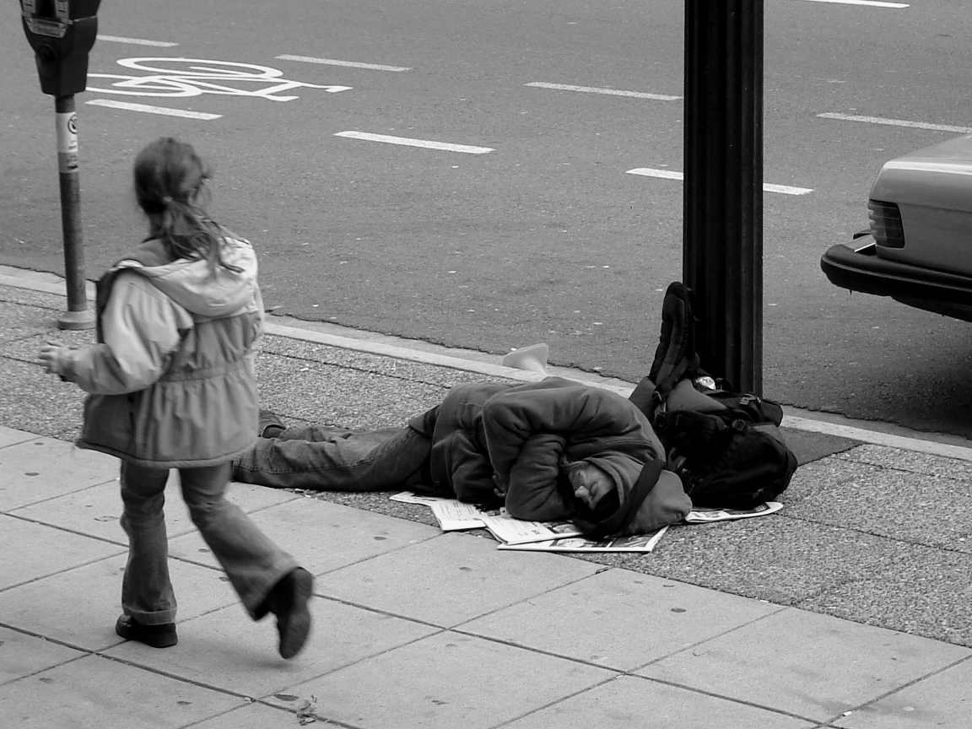
Think of this photograph as data
This photo/exercise is also on p. 2 of our Jamboard so you can see them in your breakout rooms (please put your answers on p. 3 of the Jamboard)
What social-symbolic objects do you observe?
What forms of social-symbolic work can you imagine are important to constituting the scene?
What would be a research question that you might ask about the objects and work?

