Slide 1
Overview of Theoretical Opportunities

Slide 2
Social-symbolic work in management and organization research
Self work
Emotion work
Identity work
Career work
Organization work
Strategy work
Boundary work
Technology work
Institutional work
Practice work
Category work

Slide 3
What we will talk about
What opportunities arise to explore how different forms of social-symbolic work are combined in concrete situations?
What opportunities emerge from the connections between social-symbolic objects, and the efforts of actors to shape those connections?

Slide 4
Combining forms of work
We have focused largely on instances of social-symbolic work intended to shape one type of social-symbolic object
This depiction of social-symbolic work is highly simplified and not very realistic
In real life forms of work are often combined

Slide 5


Slide 6
A Process Model of Social-Symbolic Work
Practices
Resources
Motivations
Combinations of SSW
Effects
Situatedness

Slide 7
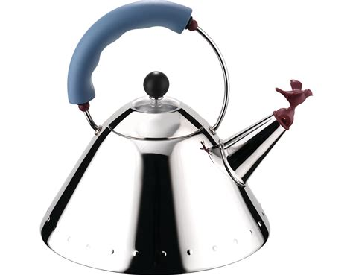

Organizational Work and Self Work

Slide 8
Strategies for Combining forms of work
Sequencing forms of social-symbolic work
Aligning forms of social-symbolic work
Integrating forms of social-symbolic work

Slide 9
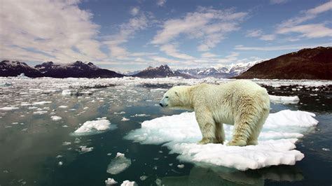
Breakout on Combining forms of SSW
In groups of 3, discuss the following:
  What combined forms of SSW have you seen performed by actors seeking to reduce carbon emissions?
  What are the costs and benefits of combining forms of SSW?
If you have any questions about combining SSW, please put them in the chat when you return.
(15 min breakout)

Slide 10
Connecting Social Symbolic Objects
Enactment
For example, a surgeon drawing on institutionalized understandings of surgeons to construct their identities
Need not be done by a single actor or done to themselves
  Enactment involves actors taking a social-symbolic object of one kind and employing it as a frame to produce a social-symbolic object of another kind

Slide 11
Connecting Social Symbolic Objects
Abstraction
For example, when a group of actors draw from across the lived experience of many to create a new category of work (“sustainability officer”) or a new category of organization (“blockchain company”)
Always an iterative, social process
We “notice” patterns, which involves constructing sets of likenesses across time and space;
we name those patterns and ascribe them emergent properties
  Abstraction involves the construction of a social-symbolic object out of the lived experience of actors

Slide 12
Connecting Social Symbolic Objects
Translation
Our conceptualization draws on translation in sociology and Scandinavian institutionalism
Translation across social contexts involves the movement, not of the ideas themselves, but of “accounts and materializations” of the idea (Sahlin & Wedlin, 2008: 225)
  Translation involves the movement of social-symbolic objects across contexts

Slide 13
Connecting Social Symbolic Objects
Inversion
For example, inversion of “queer” as a label by the LGBT community
“When a lot of lesbians and gay men wake up in the morning, we feel angry and disgusted, not gay. So we’ve chosen to call ourselves queer. Using ‘queer’ is a way of reminding us how we are perceived by the rest of the world.” (Wortham, 2016)
Examples? Type into the chat…
  Inversion involves the appropriation and reshaping of meaning, such that the meaning of a social-symbolic object is transformed, often in ways directly in contrast to the original meaning.

